Slide 1
Chapter 2: Virtualization

Slide 2
Introduction to Virtualization
Virtualization is a technology that allows multiple operating systems and applications to run independently on a single physical hardware system by abstracting hardware resources.
Key Idea
Physical resources (CPU, memory, storage, network) are decoupled from hardware.
A software layer called a hypervisor manages virtual machines (VMs).
Why Virtualization?
Better hardware utilization
Reduced cost, power, and space
Improved scalability and flexibility
Foundation of cloud computing
Real-World Example
Running Windows and Linux simultaneously on one server using VirtualBox, VMware, or Hyper-V.

Slide 3
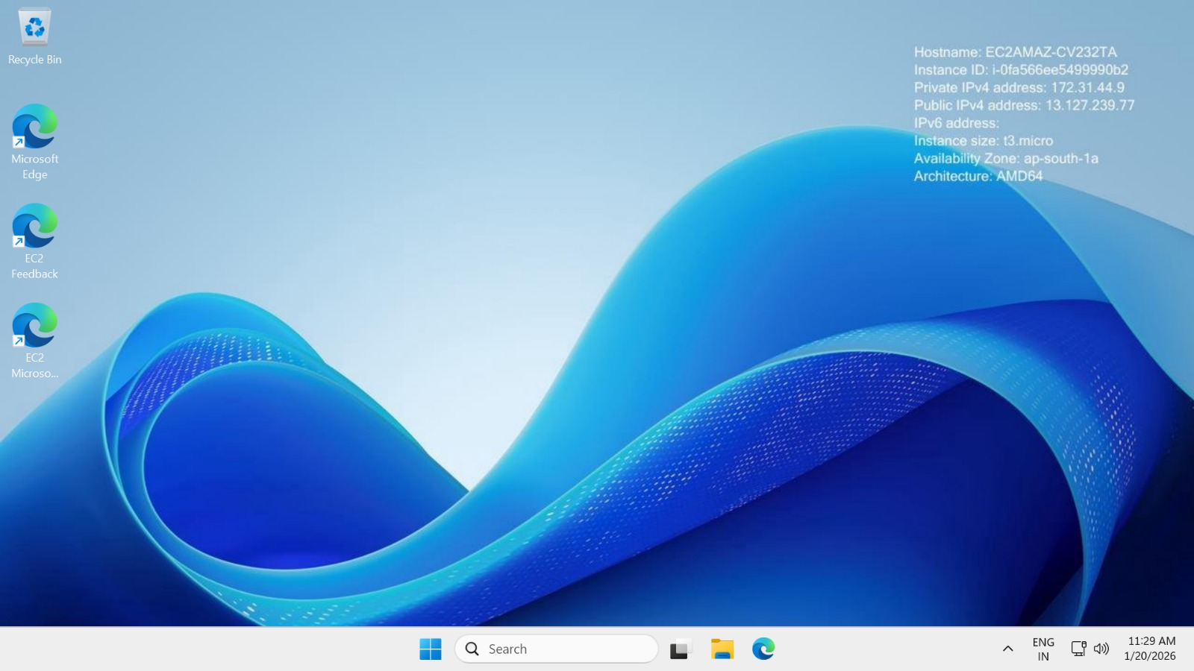
Introduction to Virtualization

Slide 4
Characteristics of Virtualized Environments
A virtualized environment has the following core characteristics:
Abstraction: Hardware details are hidden from users and applications.
VMs see virtual hardware, not physical devices.
Isolation: Each VM operates independently.
Failure or attack on one VM does not affect others.
Encapsulation: A VM is stored as a set of files.
Easy to copy, move, snapshot, or backup VMs.
Resource Sharing: CPU, memory, disk, and network are shared dynamically.
Hypervisor allocates resources as needed.
Portability: VMs can be migrated across physical servers.
Enables live migration and disaster recovery.
Scalability: Resources can be increased or decreased on demand.
Supports elastic cloud workloads.

Slide 5
Taxonomy of Virtualization Techniques
Virtualization techniques can be classified based on what is virtualized and how it is implemented.
A. Hardware Virtualization
Virtualizes physical hardware to create multiple VMs.
1. Full Virtualization
Complete hardware simulation.
Guest OS runs unchanged.
Example: VMware, VirtualBox High compatibility Performance overhead
2. Para-Virtualization
Guest OS is modified to interact with the hypervisor.
Example: Xen (para-virtual mode) Better performance OS modification required
3. Hardware-Assisted Virtualization
Uses CPU support (Intel VT-x, AMD-V).
Example: KVM, Hyper-V High performance No OS modification

Slide 6
Taxonomy of Virtualization Techniques
Operating System-Level Virtualization (Containerization)
Single OS kernel shared by multiple containers.
Example: Docker, LXC Lightweight Fast startup Same OS required
C. Server Virtualization
One physical server → multiple virtual servers.
Common in data centers and cloud platforms.
D. Storage Virtualization
Combines multiple storage devices into one logical unit.
Example: SAN, NAS Improved storage utilization

Slide 7
Taxonomy of Virtualization Techniques
Operating System-Level Virtualization (Containerization)
Single OS kernel shared by multiple containers.
Example: Docker, LXC Lightweight Fast startup Same OS required
C. Server Virtualization
One physical server → multiple virtual servers.
Common in data centers and cloud platforms.
D. Storage Virtualization
Combines multiple storage devices into one logical unit.
Example: SAN, NAS Improved storage utilization

Slide 8
Taxonomy of Virtualization Techniques
E. Network Virtualization
Virtual networks over physical infrastructure.
Example: VLAN, SDN, NFV ✔ Flexible network management
F. Desktop Virtualization
User desktops run on centralized servers.
Example: VDI (Virtual Desktop Infrastructure)

Slide 9
Session Summary
Virtualization enables multiple OSs on one piece of hardware.
Hypervisor manages VMs.
Key features: abstraction, isolation, encapsulation.
Types: hardware, OS-level, server, storage, network.
Foundation technology of cloud computing.

